Slide 1





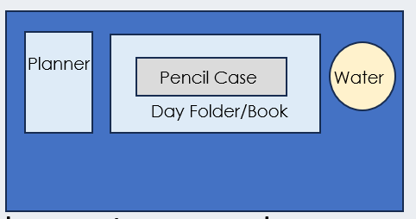

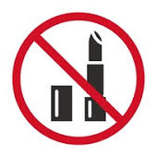

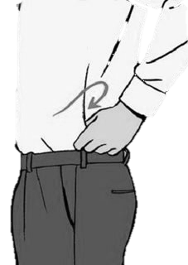


After the register, I am checking your….
Desk
Uniform
SLANT
All subject books go into your bag
(not floor or shelf!)
Notes:
This is you setting your expectation – issue demerits for uniform/equipment if they do not meet your expectation after this.

Slide 2







Read Now
Thursday 15 January 2026
Global Warming
Task:
Complete the Read Now by:
Stick in the sheet.
Using a highlighter as you read to identify key terms.
Answer the first four recall questions under the sheet in your book.
Answer the stretch question
Aim High | Work Together | Be Kind | Lead the Way

Slide 3
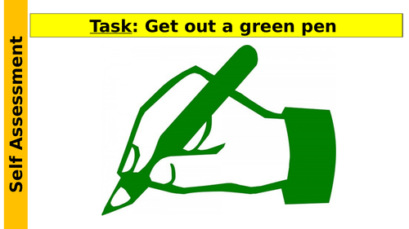
Read Now
Answers:
B
Heat
Burning fossil fuels (coal, oil, and gas)
farming (especially cows) (or also landfill sites / fossil fuel extraction)
They trap more heat in the atmosphere, causing the Earth’s temperature to rise.
The Earth’s temperature would decrease because less heat would be trapped in the atmosphere.
Aim High | Work Together | Be Kind | Lead the Way

Slide 4
Daily Review
Follow your teachers instructions:
“When I say go show me a MWB and a MWB Pen”
You will have 10 seconds for each question.
Hold your MWB in the Ready position
“Show me”
You need to score 70% to pass
Subtitle ‘test score’ ?/10
Aim High | Work Together | Be Kind | Lead the Way
Notes:
Teachers remember to input the quiz score

Slide 5
MWB Quiz
What is the name of an organism that eats other organisms?
What is used to increase the yield of a farmer’s field?
What is the term for an extreme food shortage?
What is the term for having enough food to feed a population?
What is the process of minerals moving through the soil due to rain fall?

Slide 6
MWB Quiz
What is the name of an organism that eats other organisms? Predator
What is used to increase the yield of a farmer’s field? Fertiliser
What is the term for an extreme food shortage? Famine
What is the term for having enough food to feed a population? Food security
What is the process of minerals moving through the soil due to rain fall? Leaching

Slide 7

Following this lesson, students will be able to:
Describe what is happening to carbon dioxide and methane levels in the atmosphere
Describe some causes of these greenhouse gases
Describe the biological consequences of global warming
Key Words:
global warming
climate change
emissions
greenhouse gas
Notes:
Can be edited depending on class need.

Slide 8
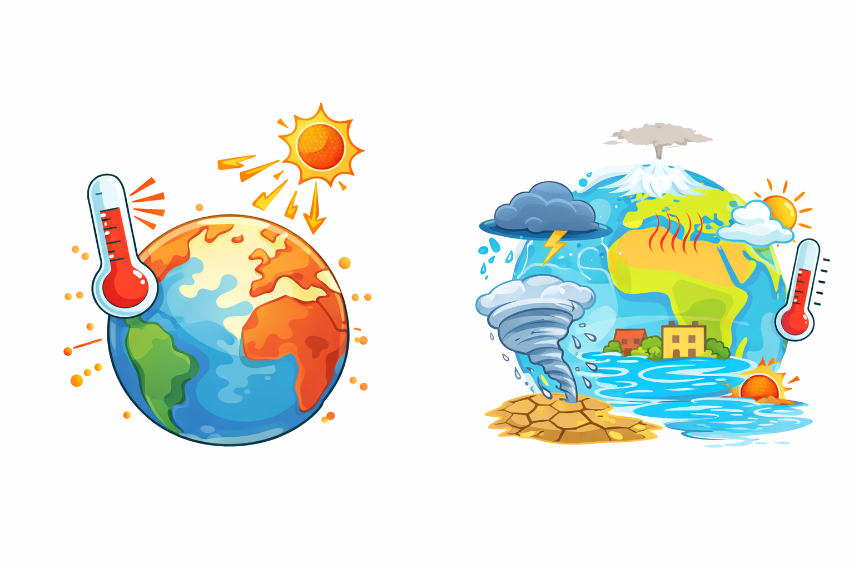
Global warming is the Earth’s average temperature is increasing because greenhouse gases trap heat.
Climate change is the long-term changes in weather, such as temperature, rainfall, and storms.
Notes:
Why is there more rainfall?
Higher temperatures cause more water to evaporate from oceans, rivers, and lakes.
This puts more water vapour into the air.
When the air cools, that extra water falls as heavier rain.
Heavier rain in a short time = flooding.

Slide 9
Which statement best describes global warming?
1. Short-term changes in daily weather
2. The rise in Earth’s average temperature
3. Changes in rainfall and storms
4. Seasonal weather differences

Slide 10
Which is an example of climate change?
1. A hot day in summer
2. A cold winter
3. More floods and droughts over many years
4. The temperature at lunchtime

Slide 11
Which is an example of climate change?
1. A hot day in summer
2. A cold winter
3. More floods and droughts over many years
4. The temperature at lunchtime

Slide 12
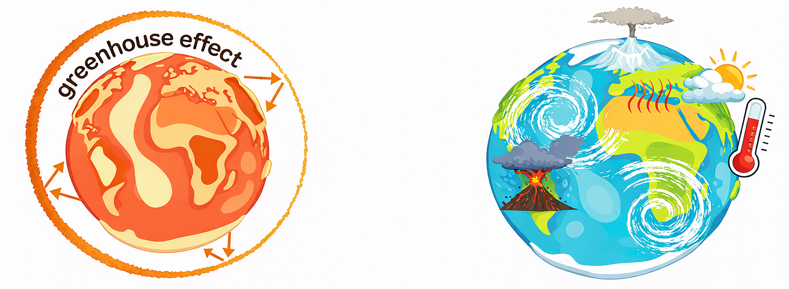
Explain the difference between global warming and climate change.
Global warming is….
whereas
climate change is…
Key word: Temperature weather long-term increase changing average
Notes:
Why is there more rainfall?
Higher temperatures cause more water to evaporate from oceans, rivers, and lakes.
This puts more water vapour into the air.
When the air cools, that extra water falls as heavier rain.
Heavier rain in a short time = flooding.

Slide 13
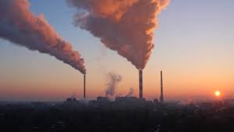
Carbon dioxide is released when:
Fossil fuels are burned
Cars are used
Factories make electricity
Methane is released from:
Farming (especially cows)
Landfill sites
Fossil fuel extraction
Notes:
Carbon dioxide is released when humans burn fossil fuels.
Methane traps more heat than carbon dioxide.

Slide 14
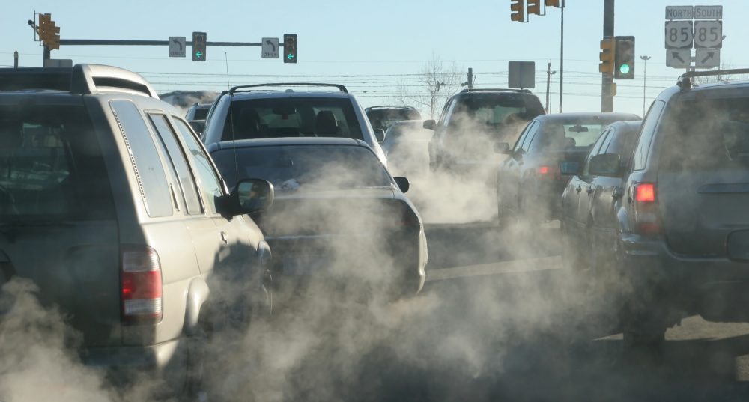
Notes:
co2

Slide 15
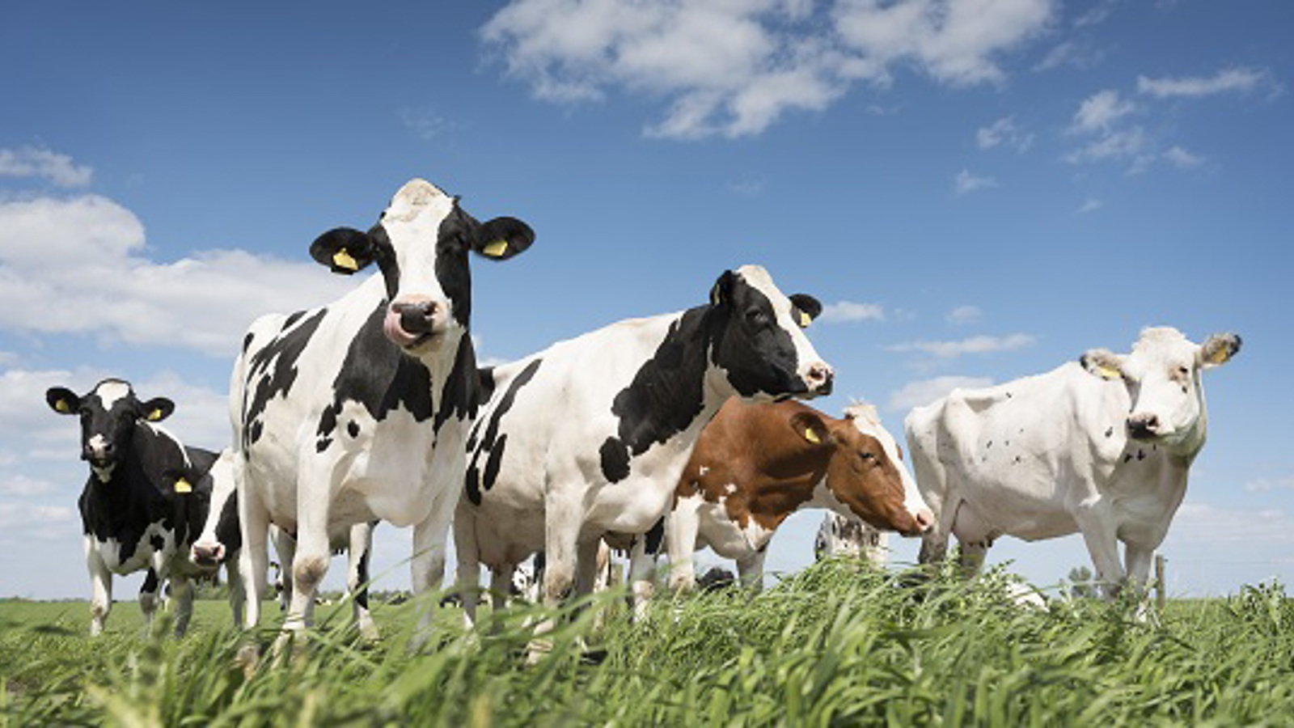
Notes:
Cows eat grass and plants.
Inside a cow’s stomach, bacteria break down the food.
This process makes methane gas.
The methane is released when cows burp (and sometimes fart

Slide 16
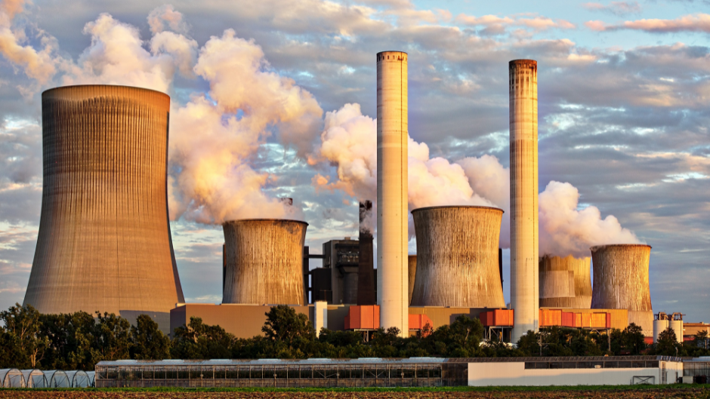

Slide 17
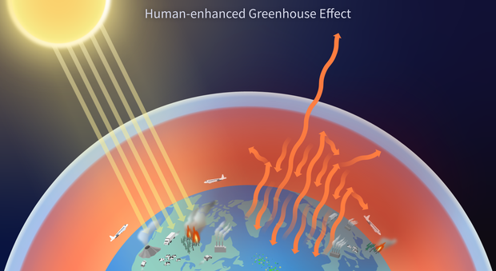
Greenhouse gases include:
Carbon dioxide (CO₂)
Methane (CH₄)
What they do:
Trap heat in the atmosphere
In the atmosphere:
Carbon dioxide levels are increasing
Methane levels are increasing
Notes:
Sentence to repeat:
Greenhouse gases trap heat

Slide 18
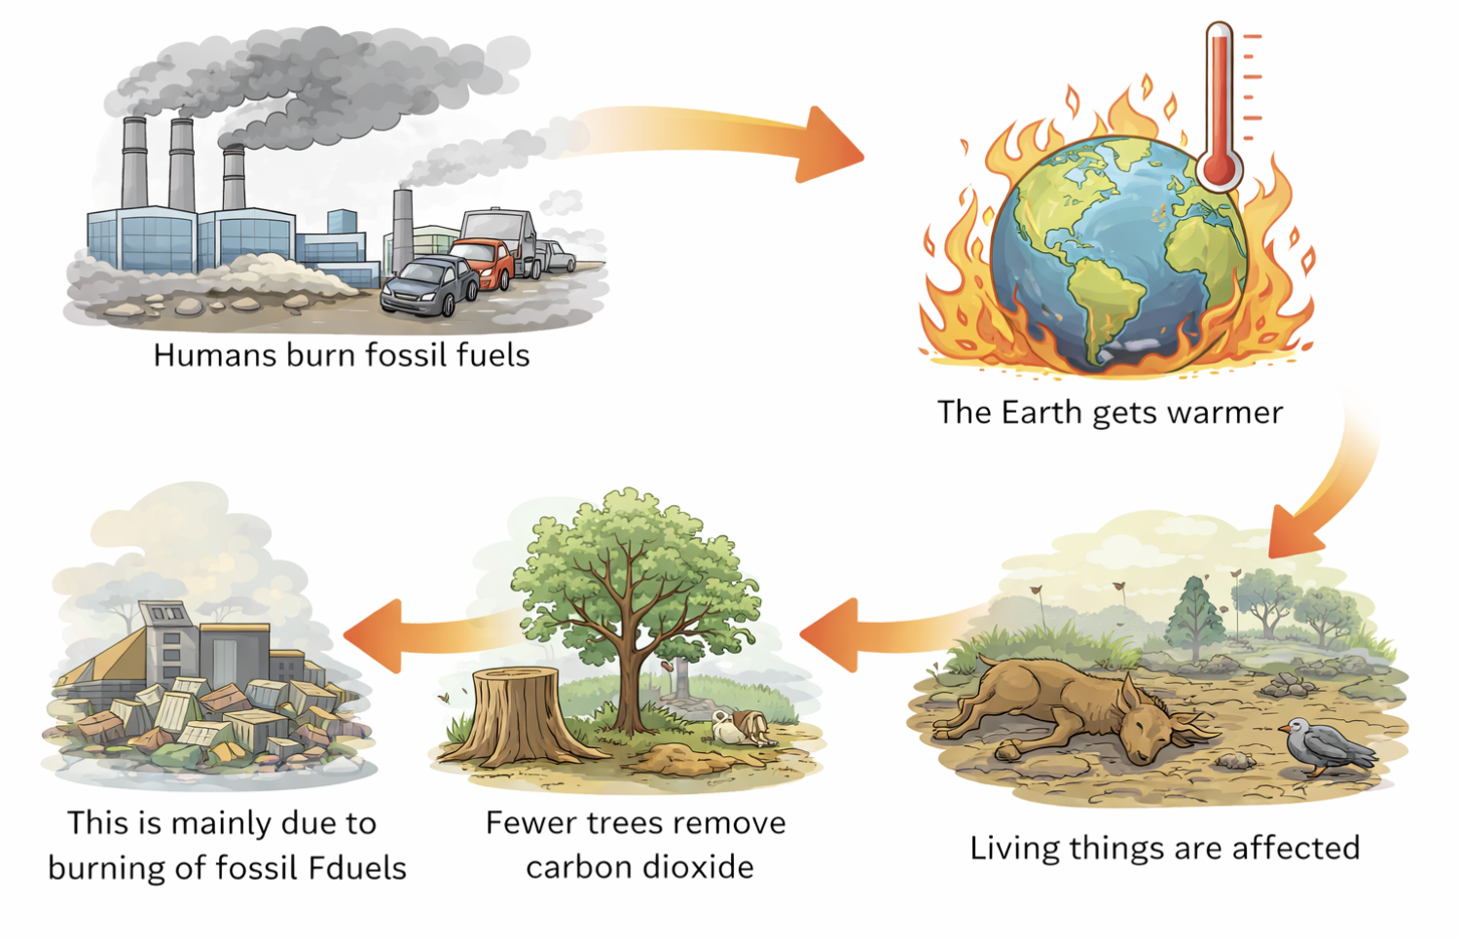
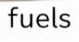
Notes:
Purpose: introducing new knowledge
Suggested Script:
This graph shows the increasing global temperature, we will now discuss what is causing this.
The amount of carbon dioxide and methane in the atmosphere has increased dramatically in the last 60 years. Why do you think this is? Burning fossil fuels- by industries and individuals (at home and when using cars/planes etc).
Another reason the levels of these gases have increased is due to deforestation. Trees absorb a vast amount of CO₂ during photosynthesis so when a large number of trees have been cut down in an area that is a lot of CO₂ that remains in the atmosphere instead of being absorbed.
Having high levels of these gases in the atmosphere is not good news as they both (as well as others such as nitrous oxide and CFCs) are known as greenhouse gases that contribute to global warming via the greenhouse effect. We will study this fully in physics but the greenhouse effect happens when gases trap heat from the Sun in the Earth’s atmosphere rather than allowing it to be reflected back into space. Over time this leads to increased temperatures and thus, global warming.
We can see from the graph that global temperature fluctuates but there has been an overall increase of 0.51ºC in the last approx. 50 years. While this change may seem small, it is thought by scientists that a 2ºC increase in global temperature would cause ‘catastrophic’ impacts on Earth.
Paris climate agreement aims to keep global temperature increase below 1.5 degrees Celsius (many studies suggest there is less than 1% change of achieving this goal) and 2 degrees Celsius is accepted as the temperature change that would cause ‘catastrophic’ impact on the Earth.
Image source:
https://commons.wikimedia.org/wiki/File:20200324_Global_average_temperature_-_NASA-GISS_HadCrut_NOAA_Japan_BerkeleyE.svg
Suggested guidance: Pupils will learn more about the scientific process of global warming when they study black body radiation in physics. At this point/level the focus is on the causes consequences of global warming, but a brief explanation may be useful to help pupils gain a deeper understanding: Greenhouse gases become trapped in the atmosphere and prevent radiation from the sun being able to be reflected fully from the Earth. Useful analogy is to imagine the Earth has now got an extra layer/jacket on it so the heat that the body produces gets trapped and it heats up – there are several limitations with this model. Be careful that students are aware that Earth’s heat comes from the sun rather than the earth itself – it is absorbed and then partially reflected (the natural greenhouse effect). Greenhouse gases have increased this effect so that the excess heat is not able to escape the atmosphere.
An international treaty called the Paris Agreement has been signed by 197 countries. This is an international legal agreement to substantially reduce global greenhouse gas emissions to limit the global temperature increase in this century to 2 degrees Celsius while pursuing efforts to limit the increase even further to 1.5 degrees
It may be useful for pupils to look at further data on the carbon dioxide concentration in the atmosphere over the last 200 years and open a discussion to suggest why this is. They should have covered the industrial revolution in history and also be able to understand the impact of huge levels of transport (burning fossil fuels), in addition to industry and manufacturing.
This can also be a good opportunity to discuss the climate change denialist point of view and the development of scientific theories, based on the production of evidence that either supports or refutes the theory. The following video features Professor Brian Cox sparring against an Australian senator who argues that climate change is not related to human activity:
https://www.youtube.com/watch?v=lf3TGmaLXow
The following guardian article features a readable summary debunking the 3% of scientists whose evidence refutes the theory:
https://www.theguardian.com/environment/climate-consensus-97-per-cent/2016/jul/25/these-are-the-best-arguments-from-the-3-of-climate-scientist-skeptics-really

Slide 19
MCQ: What is happening to carbon dioxide and methane levels in the atmosphere?
They are decreasing
They are staying the same
They are increasing
They are disappearing
Notes:
Purpose: introducing new knowledge
Suggested Script:
You may have heard of both global warming and climate change. Nowadays you tend to hear more about climate change in the news, this is because climate change refers to all changes in weather patterns including temperature, sun, rain and wind whereas global warming only refers to an increased temperature.
Suggested guidance – exam specifications still refer to global warming, which is the rise in global temperatures due to greenhouse gases. Wider media now refer to climate change, which is the overall change in weather over a longer period of time and includes temperature, precipitation and wind patterns. This is a frequently asked question by pupils.

Slide 20
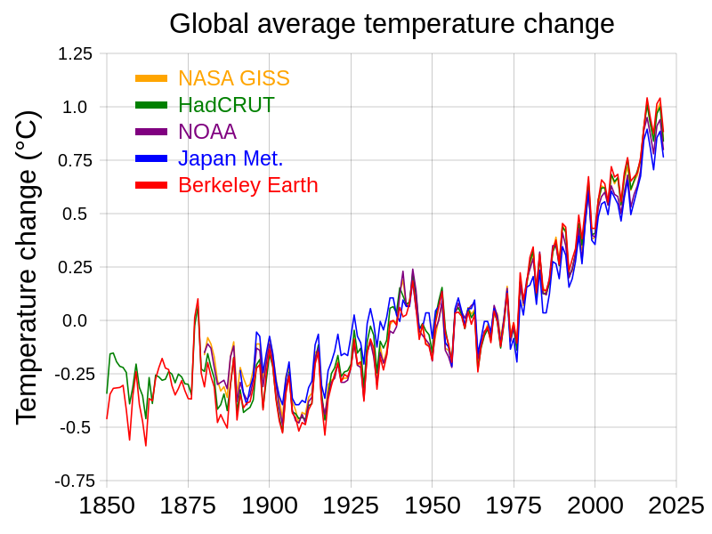
Global Warming
The Earth’s global average temperature has increased by about 1°C
This is the average temperature of the whole planet, all year round
Even this small increase has already caused major changes
Notes:
The last Ice Age was only about 5°C colder than today — and the UK was covered in ice.
“One degree doesn’t sound like much… but your body changing by 1°C means you’re ill.”
What actually happens:
Warmer oceans melt ice from underneath
Slightly warmer summers melt ice a bit more each year
Ice melts faster than it refreezes

Slide 21
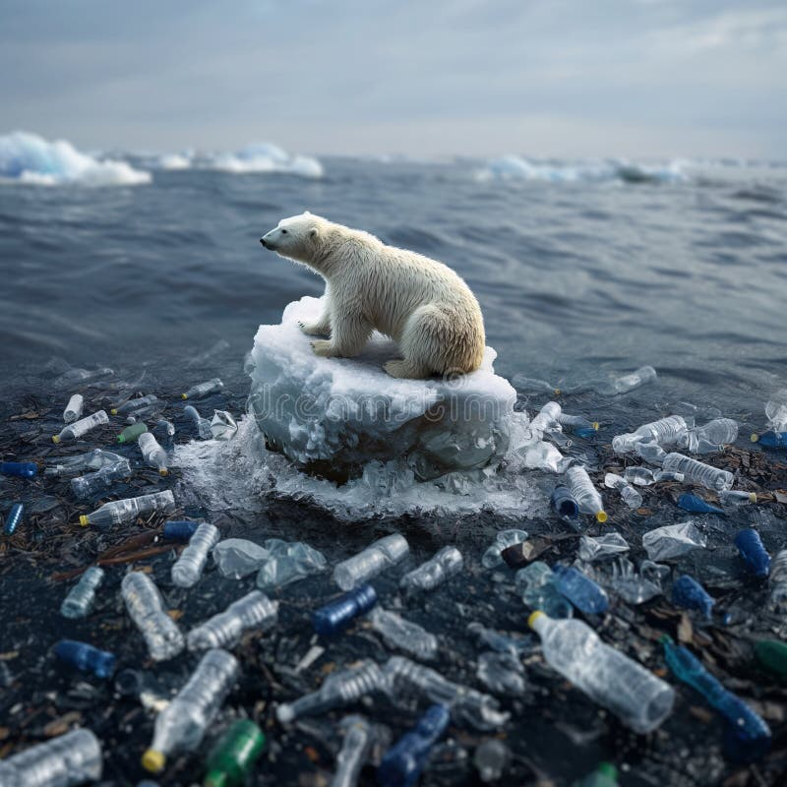
Consequences of Global Warming
The consequences of global warming are:
Melting polar ice caps
Rising sea levels
Flooding
Extreme weather patterns

Slide 22
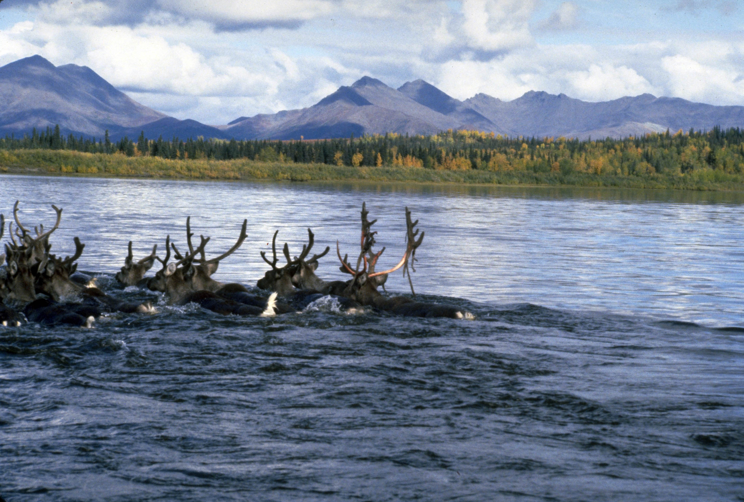
Consequences of Global Warming
The biological consequences of global warming are:
Loss of habitats
changing breeding patterns
changing migratory patterns
These biological consequences cause changes to the biodiversity of an area.
Notes:
Purpose: introducing new knowledge
Suggested Script:
Highlight the biological consequences as these are often forgotten. The previous slide were all abiotic factors that are changing.
Habitats often lost as a result of the other abiotic consequences.
Changing in breeding and migration patterns of various animals- it has been reported that arctic reindeer are migrating to give a day earlier per year (this was measured over 15 years), thought to be due to global warming. Arctic reindeer migrate to give birth, if the baby reindeer are born earlier in the year there is more chance they will encounter freak storms and if they do so it is likely they will not survive.
Ensure biological changes are linked to altered biodiversity. How will a loss of habitats affect biodiversity in an area? Biodiversity will decrease because the organisms will have to either find a new habitat or die.
Suggested Guidance
There are several other consequences that pupils may suggest but these are the key consequences covered in media. Most pupils will be aware of these but it is useful to go into how each of them is a consequence and the knock on effects those consequences may have, e.g. many pupils will have seen news stories about the Australian forest fires.
See article here about arctic reindeer : https://www.newscientist.com/article/2259144-arctic-animals-are-migrating-earlier-in-the-year-due-to-climate-change/
This website shows the projected areas that will be underwater by year – particularly interesting to show areas like Bangladesh:
https://coastal.climatecentral.org/map/7/89.0929/23.4024/?theme=sea_level_rise&map_type=year&contiguous=true&elevation_model=best_available&forecast_year=2030&pathway=rcp45&percentile=p50&return_level=return_level_1&slr_model=kopp_2014
Image source
https://commons.wikimedia.org/wiki/File:Swimming_the_Kobuk_(8510280141).jpg

Slide 23
Which of the following is a biological consequence of global warming that can reduce biodiversity?
1. An increase in fossil fuel use
2. Loss of habitats
3. More cars on the road
4. Higher carbon dioxide emissions
Notes:
Purpose: introducing new knowledge
Suggested Script:
You may have heard of both global warming and climate change. Nowadays you tend to hear more about climate change in the news, this is because climate change refers to all changes in weather patterns including temperature, sun, rain and wind whereas global warming only refers to an increased temperature.
Suggested guidance – exam specifications still refer to global warming, which is the rise in global temperatures due to greenhouse gases. Wider media now refer to climate change, which is the overall change in weather over a longer period of time and includes temperature, precipitation and wind patterns. This is a frequently asked question by pupils.

Slide 24
Which of the following is a consequence of global warming?
Increased recycling
Melting polar ice caps
Reduced greenhouse gases
Fewer cars on the road
Notes:
Purpose: introducing new knowledge
Suggested Script:
You may have heard of both global warming and climate change. Nowadays you tend to hear more about climate change in the news, this is because climate change refers to all changes in weather patterns including temperature, sun, rain and wind whereas global warming only refers to an increased temperature.
Suggested guidance – exam specifications still refer to global warming, which is the rise in global temperatures due to greenhouse gases. Wider media now refer to climate change, which is the overall change in weather over a longer period of time and includes temperature, precipitation and wind patterns. This is a frequently asked question by pupils.

Slide 25
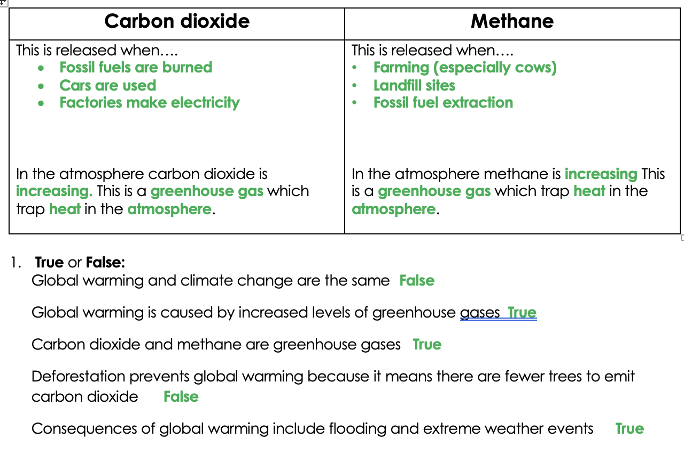
Notes:
Purpose: introducing new knowledge
Suggested Script:
Highlight the biological consequences as these are often forgotten. The previous slide were all abiotic factors that are changing.
Habitats often lost as a result of the other abiotic consequences.
Changing in breeding and migration patterns of various animals- it has been reported that arctic reindeer are migrating to give a day earlier per year (this was measured over 15 years), thought to be due to global warming. Arctic reindeer migrate to give birth, if the baby reindeer are born earlier in the year there is more chance they will encounter freak storms and if they do so it is likely they will not survive.
Ensure biological changes are linked to altered biodiversity. How will a loss of habitats affect biodiversity in an area? Biodiversity will decrease because the organisms will have to either find a new habitat or die.
Suggested Guidance
There are several other consequences that pupils may suggest but these are the key consequences covered in media. Most pupils will be aware of these but it is useful to go into how each of them is a consequence and the knock on effects those consequences may have, e.g. many pupils will have seen news stories about the Australian forest fires.
See article here about arctic reindeer : https://www.newscientist.com/article/2259144-arctic-animals-are-migrating-earlier-in-the-year-due-to-climate-change/
This website shows the projected areas that will be underwater by year – particularly interesting to show areas like Bangladesh:
https://coastal.climatecentral.org/map/7/89.0929/23.4024/?theme=sea_level_rise&map_type=year&contiguous=true&elevation_model=best_available&forecast_year=2030&pathway=rcp45&percentile=p50&return_level=return_level_1&slr_model=kopp_2014
Image source
https://commons.wikimedia.org/wiki/File:Swimming_the_Kobuk_(8510280141).jpg

Slide 26
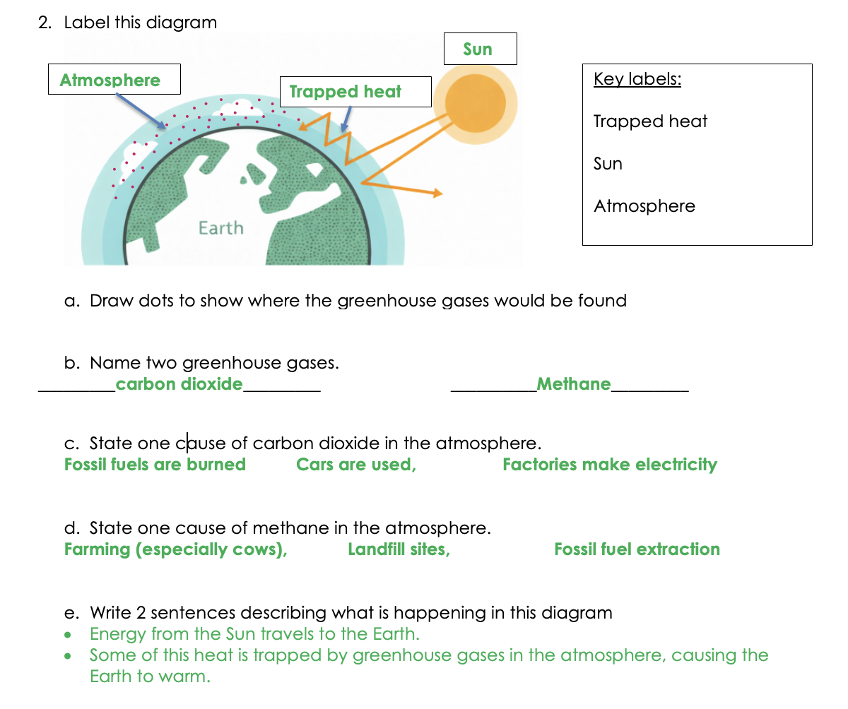
Notes:
Purpose: review of new information.
Use thumbs up/down for true and false – allowing thinking time and 3,2,1 to prevent copying.
Answers:
False – global warming refers to the increasing temperature, climate change refers to the overall changing weather patterns and includes temperature, precipitation and winds.
True
True
False – deforestation means that there are fewer trees to absorb carbon dioxide, thereby increasing the greenhouse effect.
True

Slide 27
Notes:
Purpose: review of new information.
Use thumbs up/down for true and false – allowing thinking time and 3,2,1 to prevent copying.
Answers:
False – global warming refers to the increasing temperature, climate change refers to the overall changing weather patterns and includes temperature, precipitation and winds.
True
True
False – deforestation means that there are fewer trees to absorb carbon dioxide, thereby increasing the greenhouse effect.
True

Slide 28
3. Global warming can affect plants and animals because higher temperatures and changes in weather can damage their habitats.
Some plants and animals may not be able to survive or may have to move to new areas.
4. Higher global temperatures, More extreme weather (heatwaves, storms, floods), Melting ice caps and glaciers
5. Loss of habitats, so some plants and animals die, Species become extinct when they cannot survive new conditions
6. Increasing greenhouse gases can lead to a decrease in biodiversity because they trap more heat in the atmosphere, causing global warming.
This leads to climate change and extreme weather, which can destroy habitats, so some plants and animals cannot survive.
Notes:
Purpose: review of new information.
Use thumbs up/down for true and false – allowing thinking time and 3,2,1 to prevent copying.
Answers:
False – global warming refers to the increasing temperature, climate change refers to the overall changing weather patterns and includes temperature, precipitation and winds.
True
True
False – deforestation means that there are fewer trees to absorb carbon dioxide, thereby increasing the greenhouse effect.
True

Slide 29
Quick Quiz
Determine if the following statements are true or false:
Global warming and climate change are the same
Global warming is caused by increased levels of greenhouse gases
Carbon dioxide and methane are greenhouse gases
Deforestation prevents global warming because it means there are fewer trees to emit carbon dioxide
Consequences of global warming include flooding and extreme weather events
False
True
True
False
True
Notes:
Purpose: review of new information.
Use thumbs up/down for true and false – allowing thinking time and 3,2,1 to prevent copying.
Answers:
False – global warming refers to the increasing temperature, climate change refers to the overall changing weather patterns and includes temperature, precipitation and winds.
True
True
False – deforestation means that there are fewer trees to absorb carbon dioxide, thereby increasing the greenhouse effect.
True

Slide 30
Answer the questions below.
Which is the best definition of global warming?
A. Changing weather patterns
B. The Earth getting hotter
C. The increase in the overall temperature of the Earth’s atmosphere
2. Which is not a consequence of global warming?
A. Rising sea levels and flooding
B. Fossil fuels being burned
C. Extreme weather patterns
3. Which would be an action to reduce greenhouse gas emissions?
A. Cutting down trees
B. Using renewable energy sources
C. Burning waste instead of sending it to landfill
✓
✓
✓
Notes:
Q1. Answer: C
If students answer A, they have mistaken global warming for climate change. If they answer B, they have not identified the true definition of global warming. To fix-it, go through the definitions of global warming and climate change and ask pupils to identify the differences.
Q2. Answer: B
If students answer B or C, they have confused cause and effect/consequence, so the error is most likely due to this misunderstanding rather than content. To fix-it, you could describe other cause and effect examples eg what is the consequence if you don’t do your homework? To find the effect, ask yourself: “What happened?” To find the cause, ask yourself: “Why did it happen?” Cause: didn’t do homework. Effect/consequence: school sanction.
Q3. Answer: B
If students answer A or C, they have identified actions that contribute to greenhouse gases rather than reducing. To fix-it, go through each example and ask would this increase the levels of CO2 and why or why not.

